Slide 1
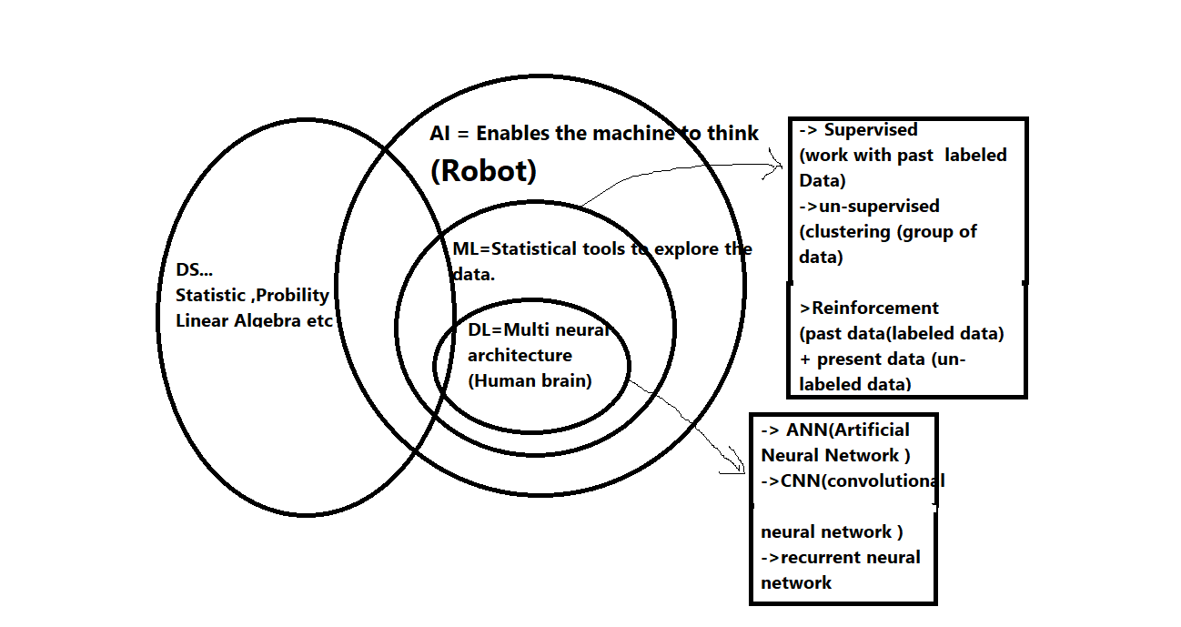
-> what is the difference between AI,ML,DL,DS

Slide 2
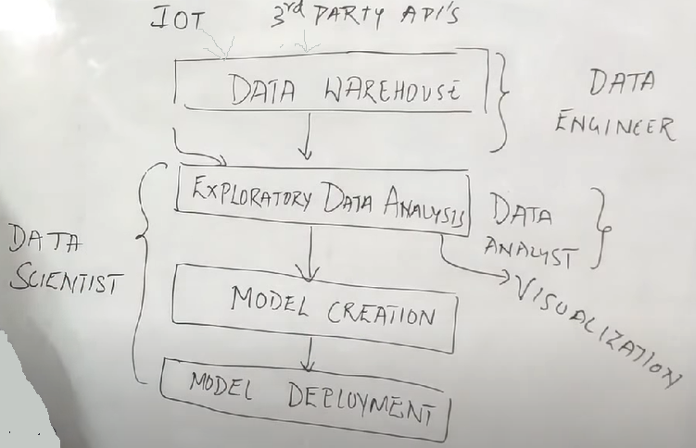
->What is Difference Between Data Engineer vs Data Analyst vs Data Scientist
->Example of Data Science
1. Youtube video..... Automatically come your favourite video on youtube home page
2. spelling suggest when you write a single character in your WhatsApp
3.Google Map
4.Flipcart suggest your favourite product

Slide 3
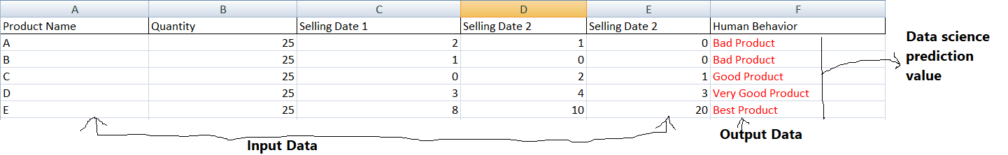
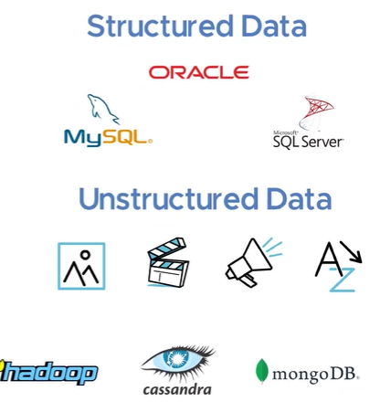
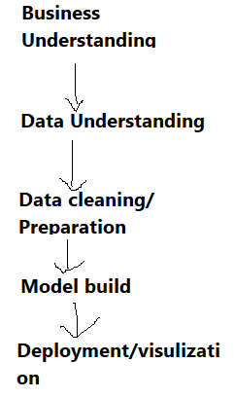
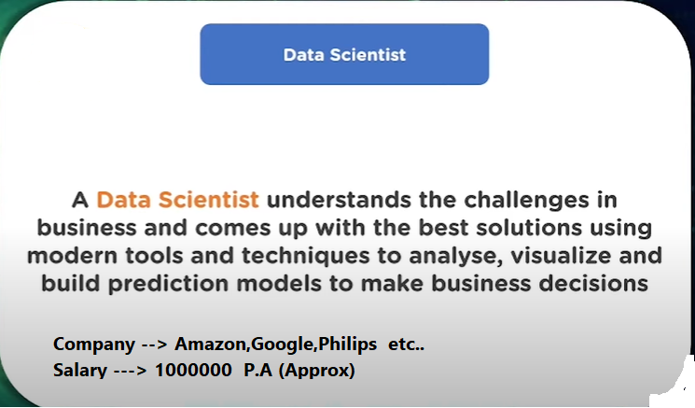
-> How to learn Data Science smartly
1.Programming Language ( Python or R or Java )
python→ basic ,Library ..Numpy ,Pandas (for data )
2. Learn statistics (mathematical part)
3.Data visualisation(Library .. matplotlib , seaborn )
4.Machine Learning ( Supervised & Unsupervised ) for model create
5. Project
..............................................................................................................................................................................
->why data science much more important in this situation
Life Cycle
Job Roles of Data Science

Slide 4
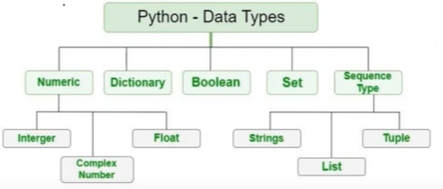
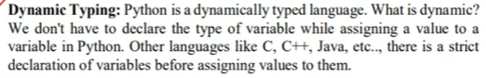
Programming Concept (Python)
-> Install Python software and Jupyter
https://www.python.org/downloads/
2. Install jupyter
(C:\Users\Somnath\AppData\Local\Programs\Python\Python38-32\Scripts>pip install jupyter)
3. Open Jupyter
(C:\Users\Somnath\AppData\Local\Programs\Python\Python38-32\Scripts>jupyter notebook)
.......................................................................................................................................................................................................................
-> Data Type & variable
Declare variable and data type in python ---
No need to declare any data type in python !!!
a=12 b=“aa” c=12.5
Type(a)
Why ...?

Slide 5
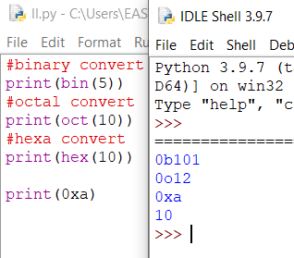
-> Struct in Python
The struct module in Python is used to convert native Python data types such as strings and numbers into a string of bytes and vice versa.
import struct
# Format: h is short
# Format: l is long
# Format 'hhl' stands for 'short short long'
var = struct.pack('hhl',1,2,3)
print(var)
# '?' -> _BOOL , 'h' -> short, 'i' -> int and 'l' -> long
var = struct.pack('?hil', True, 2, 5, 445)
print(var)
tup = struct.unpack('?hil', var)
print(tup)
# q -> long long int and f -> float
var = struct.pack('qf', 5, 2.3)
print(var)
tup = struct.unpack('qf', var)
print(tup)
#hexadecimal convert
var = struct.pack('b', 11)
print(var)
#String Convert into byte
string = "Hello World"
# string with encoding 'utf-8'
arr = bytes(string, 'utf-8')
# actual bytes in the the string
for byte in arr:
print(byte, end=' ')
print("\n")
->Number System in Python

Slide 6
-> strings
Strings are immutable (not changable ) in python. A string can only be replaced with a new string since its content can not be partially replaced
->String Operators
-> Python Formatting Operator
s="hello"; s[0]='j'; print(s);
Error:-
Traceback (most recent call last):
File "C:/Users/Somnath/Desktop/pac.py", line 2, in <module>
s[0]='j';
TypeError: 'str' object does not support item assignment
s="hello"; s="hello2"; print(s);
Output-
hello2
str = "Hello" str1 = " world" print(str*3) # prints HelloHelloHello print(str+str1)# prints Hello world print(str[4]) # prints o print(str[2:4]); # prints ll print('w' in str) # prints false as w is not present in str print('wo' not in str1) # prints false as wo is present in str1. print("The string is : %s"%(str)) # prints The string str : Hello
a=12; b=12.5; c="somnath"; print("my name is %s,age is %d,markes is %f"%(c,a,b));

Slide 7
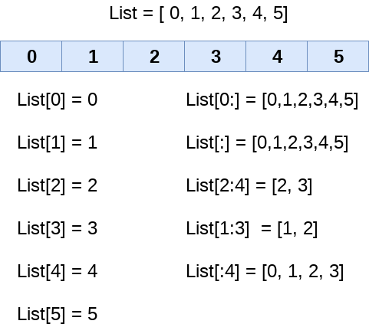
-> Python List
A list can be defined as a collection of values or items of different types. The items in the list are separated with the comma (,) and enclosed with the square brackets [].
List indexing and splitting->
emp = ["som", 102, "india"]; print("Name : %s, ID: %d, Country: %s"%(emp[0],emp[1],emp[2]))
//Backwordd Direction List display
emp = ["som", 102, "india"]; print(emp[-1]);

Slide 8
->Updating List values
Lists are the most versatile data structures in python since they are mutable and their values can be updated by using the slice and assignment operator.
Python also provide us the append() method which can be used to add values to the string.
List = [1, 2, 3, 4, 5, 6,2] print(List) List[2] = 10; #update 2 index value print(List) List[1:3] = [89, 78] # 1 and 2 index are del print(List) #del List[0] # del perticular index #List.remove(5); # remove 5 value #print(List); #append list my_list = ['gtech', 'for'] another_list = [6, 0, 4, 1] my_list.append(another_list) print (my_list) #estend List my_list1 = ['gtech', 'for'] my_list1.extend('abc'); # split value and add “a”,”b”,”c”
#my_list1.extends([25,89,83]) print (my_list1)
# use min() , max(), sum()
Python List Operations
List = [1, 2, 3, 4, 5, 6] List1=[5,8,9,6]; print(List*2); # Repetition, two times print value print(List+List1); #Concatenation, add list and List1, print(2 in List); # Membership, print True if 2 include in List for l in List: #Iteration print value print(l); print(len(List)); # return Length
List Built-in functions
List = [1, 2, 3, 4, 5, 6] List1=[5,8,9]; List1.clear(); # empty List print(List1); List1=List.copy(); #copy List print(List1); print(List.count(4)); # haw many 4 include in your List print(List.index(4)) # index value return that contain 4 List.insert(2,12); # 2 index ,12 value put not Replace ( List.append(20) its mean add 20 end of list) print(List); print(List.pop()); # List.pop(-2) that means del reverse second position value List.reverse(); # reverse List not sorting print(List); List.sort(reverse=False); # List sort Asc order print(List);

Slide 9
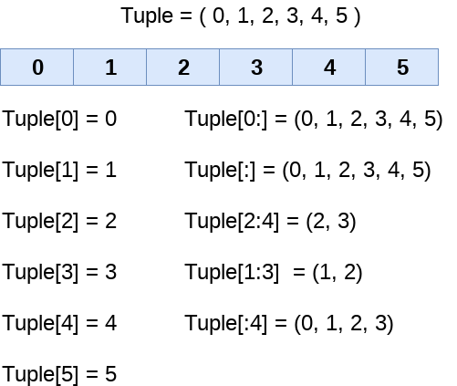
-> Python Tuple
Python Tuple is used to store the sequence of immutable python objects. Tuple is similar to lists since the value of the items stored in the list can be changed whereas the tuple is immutable and the value of the items stored in the tuple can not be changed.
Tuple indexing and splitting
tuple1 = (10, "abc", 30, 40.5, 50, 60) print(tuple1) ;
List and Tuple Operation Same
List VS Tuple:-
List->
The list Is used in the scenario in which we need to store the simple collections with no constraints where the value of the items can be changed.
Tuple->
The tuple is used in the cases where we need to store the read-only collections i.e., the value of the items can not be changed. It can be used as the key inside the dictionary.
Nesting List and tuple
a= [(101, "Ayush", 22), (102, "john", 29), (103, "james", 45), (104, "Ben", 34)] print(a); print(a[0])
Possiable to add another value in Tuple ??
No, #using merge of tuples with the + operator you can add an element and it will create a new tuple
t = (1,2,3)
t = t + (1,8) # this t is a different object
#adding items in a specific index
t = t[:2] + (15, 20, 25) # index from 2 (value replace 1 and 8)
print(t);
# Sort and Reverse Tuple
t=(25,89,10,8);t1=[5,89,10,8]g=reversed(t);
# tuple is immutable so g store reverse value and return object reference
print(tuple(g));
# show tuple value
g1=sorted(t1,reverse=False); # sorted tuple
print(tuple(g1));

Slide 10
-> Python Set
The set in python can be defined as the unordered collection of various items enclosed within the curly braces. The elements of the set can not be duplicate. The elements of the python set must be immutable.
Unlike other collections in python, there is no index attached to the elements of the set, i.e., we cannot directly access any element of the set by the index. However, we can print them all together or we can get the list of elements by looping through the set.
Creating a set:-
Python Method ->
Days = {"Monday", "Tuesday", "Wednesday", "Thursday", "Friday", "Saturday", "Sunday"} print(Days) print(type(Days))
Another Way ...
Days = set(["Monday", "Tuesday", "Wednesday", "Thursday", "Friday", "Saturday", "Sunday"]) print(Days) print(type(Days))
Days = set(["Monday", "Tuesday", "Wednesday", "Thursday", "Friday", "Saturday", "Sunday"]) print(Days) Days.add('abc'); Days.add('xyz'); print(Days); Days.update(["Friday","July","August","September","October"]); # update set not Element print(Days); Days.discard("july"); # del july ##if not find “july” do not show any error print(Days) # Days.remove("January"); # if not find “july” show any error. #Days.pop(); #Days.clear(); # clear all set # union | operator Days1 = {"Monday","Tuesday","Wednesday","Thursday"} Days2 = {"Friday","Saturday","Sunday"} print(Days1|Days2) #printing the union of the sets #Intersection of two sets set1 = {"Ayush","John", "David", "Martin"} set2 = {"Steve","Milan","David", "Martin"} print(set1&set2) #prints the intersection of the two sets #intersection_update() method a = {"ayush", "bob", "castle"} b = {"castle", "dude", "emyway"} c = {"fuson", "gaurav", "castle"} a.intersection_update(b, c)
Print(a) # common data show (“ castle “) #Difference of two sets Days1 = {"Monday", "Tuesday", "Wednesday", "Thursday"} Days2 = {"Monday", "Tuesday", "Sunday"} print(Days1-Days2) #{"Wednesday", "Thursday" will be printed} #
FrozenSets:-
The frozen sets are the immutable form of the normal sets, i.e., the items of the frozen set can not be changed and therefore it can be used as a key in dictionary.
The elements of the frozen set can not be changed after the creation. We cannot change or append the content of the frozen sets by using the methods like add() or remove().
Frozenset = frozenset([1,2,3,4,5])
print(type(Frozenset))
print("\nprinting the content of frozen set...")
for i in Frozenset:
print(i);
Frozenset.add(6) #it is immutable that means not possiable to change .

Slide 11
-> Python Dictionary
Dictionary is used to implement the key-value pair in python. The dictionary is the data type in python which can simulate the real-life data arrangement where some specific value exists for some particular key.
In other words, we can say that a dictionary is the collection of key-value pairs where the value can be any python object whereas the keys are the immutable python object,
Creating the dictionary:->
Dict = {"Name": "Somnath","Age": 30} print("my name is "+ Dict["Name"]);
Dict = {"Name": "Somnath","Age": 30} Dict["Name"]="bhadra"; # update Dictionary print("my name is "+ Dict["Name"]);
Dict = {"Name": "Somnath","Age": 30} Dict1={}; Dict1=Dict; #copy print(Dict1); del Dict1["Name"]; print(Dict1); Dict.clear(); #clear function print(Dict); #Iterative Dict2 = {"Name": "Somnath","Age": 30} for x in Dict2.values(): #Dict2.items() show key and value print(x); #duplicate key nor support Dict3 = {"Name": "Somnath","Age": 30,"Name":"abc"} for x,y in Dict3.items(): print(x,y); #formkey function keys = {'a', 'e', 'i', 'o', 'u' } value = 'vowel' vowels = dict.fromkeys(keys, value) print(vowels); #get function use dictionary = {"message": "Hello"} data = dictionary.get("message1") # not include key return none print(data) # Hello, World! #update value dictionary["message"]="somnath"; print(dictionary);

Slide 12
9.Python Operators & Operand:-
Operator -> Operator is a Symbol like .. +,- etc
Operand -> Operand is value or variable like 5+5 , 5 is a operand
->Simple Programme
a=5+3*2**3; print(a);
Find output-=???
-> Python Comments
# single line comments
'''multiline comments '''
1. Arithmetic operators(+,-, *, /, %, **,//)
**(exponent)-> power like 2^3=8
//(floor)-> 5//2 ; Output:- 2
2. Assignment operators(+=,-=,*=,/=,%=,**=,//=)
3. Comparison operators(==,!=,>,>=,<,<=)
4. Logical operators(and,or,not)
5. Bitwise operator(&,|,^ , << , >>) (Bit
^(xor)-> The resulting bit will be 1 if both the bits are different otherwise the resulting bit will be 0.
6. Membership Operators(in ,not in )
Its use List,touple & Dictionary
7. Identity Operators(is, is not )
a=5; if type(a) is int: print("ok");

Slide 13
10.Python Decision Control:
If /if-else /nested if
11.Python Iterative Control
For/while
->break & continue & pass Statement i=1; while True: print(i); i=i+1; if(i>5): break;
-> Pass
(pass keyword is used to execute nothing; it means, when we don't want to execute code, the pass can be used to execute empty)
for i in range(0,5): if i==3: pass; else: print(i);
#if block if(1): print("ok"); # if else block if(0): print("ok"); else: print("sry"); #nested if if(1): if(1): print("ok");
-> Continue i=1; while True: print(i); i=i+1; if(i<5): continue; else: break;
#for loop for i in range(0,10): print(i,end=""); #for loop with increment 2 for j in range(0,10,2): print(j); #inner for loop for k in range(0,5): for l in range(0,5): print(l,end="");
#while loop i=0; while(i<5): print(i); i=i+1; #multiple of number j=0; while j<=10: print("%d X %d = %d \n"%(5,j,5*j)); j = j+1;

Slide 14
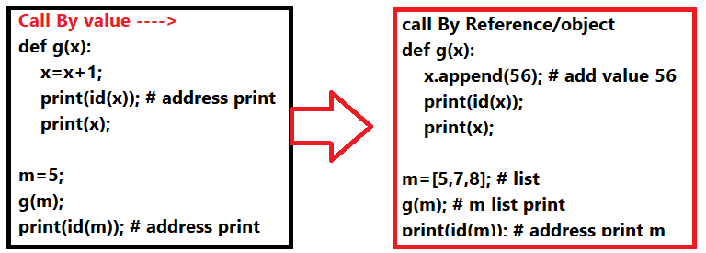
->Python Function :
A function can be defined as the organized block of reusable code which can be called whenever required.
Creating a function:-
Types of arguments:-
Required arguments
Keyword arguments
Default arguments
Variable-length arguments
->Call by reference in Python
In python, all the functions are called by reference, i.e., all the changes made to the reference inside the function revert back to the original value referred by the reference.
Argument Function
def ab(a): print(a); ab(12);
def ab(): print("ok"); ab();
String Example
def ch(str): str+="somnath"; print(str); str="hello"; ch(str); print(str); # not possiable to change original value
def ch(list1): list1.append(10); list1.append(50); print(list1); list1=[58,90,40]; ch(list1); print(list1);

Slide 15
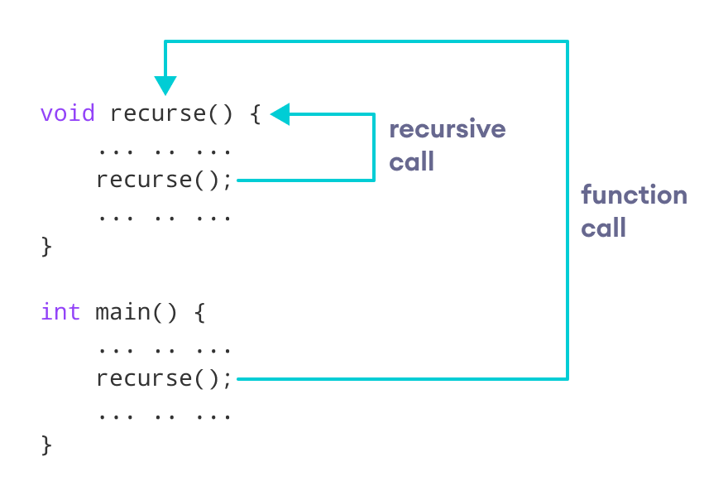
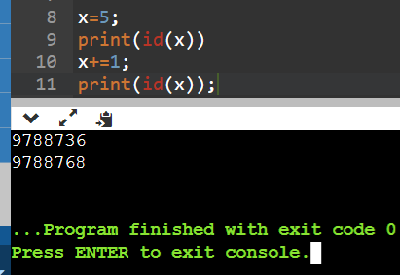
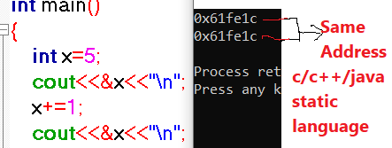
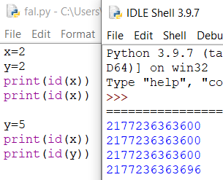
Recursion Function ....> The process in which a function calls itself directly or indirectly is called recursion and the corresponding function is called as recursive function.
Why -> Examples of such problems are Towers of Hanoi (TOH),
Inorder/Preorder/Postorder Tree Traversals ,
DFS of Graph, etc.
Pointer(Address) Concept →
Recursion Limit
import sys
#bydefault limit show
print(sys.getrecursionlimit())
#set Recursion Limit(if u want )
sys.setrecursionlimit(10000)
print(sys.getrecursionlimit())
Example ->
def fact(n):
if n==0:
return 1;
return n * fact(n-1)
python
c/c++
Value same =same address

Slide 16
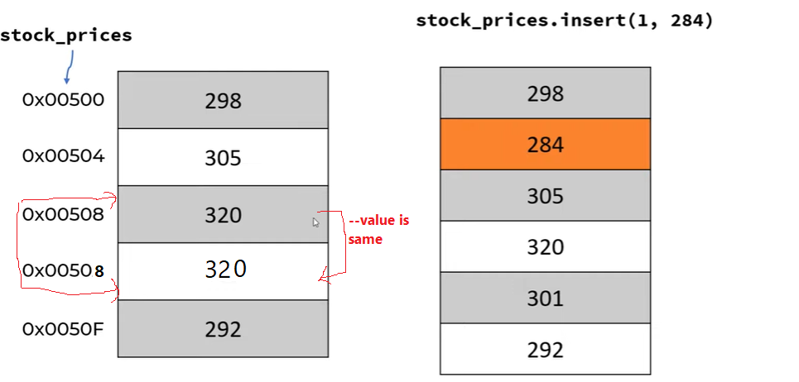
->Python Array :->
Array is mutable for Python.
Different Concept

Slide 17
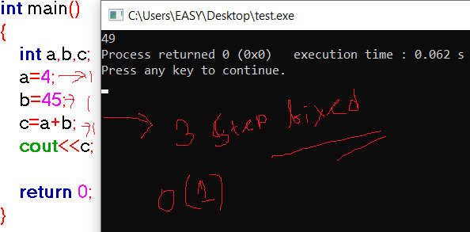
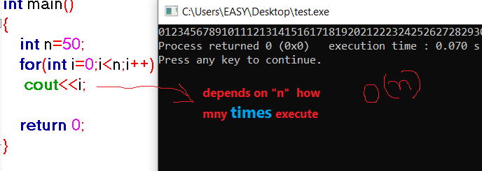
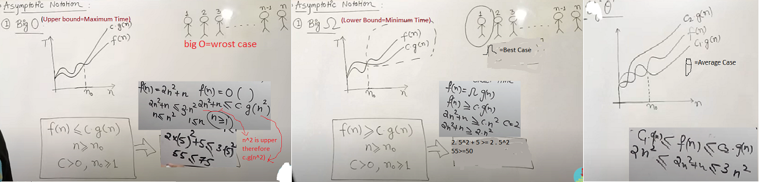
-> Time Complexity ( time taken )
...................................................................................................................................................................
->Asymptotic Notations
Following are the commonly used asymptotic notations to calculate the running time complexity of an algorithm. (Mathematical way to represent the time complexity)
-> Difference Between Best Case , Worst case & Average Case
Best case is the function which performs the minimum number of steps on input data of n elements. Worst case is the function which performs the maximum number of steps on input data of size n. Average case is the function which performs an average number of steps on input data of n elements.

Slide 18
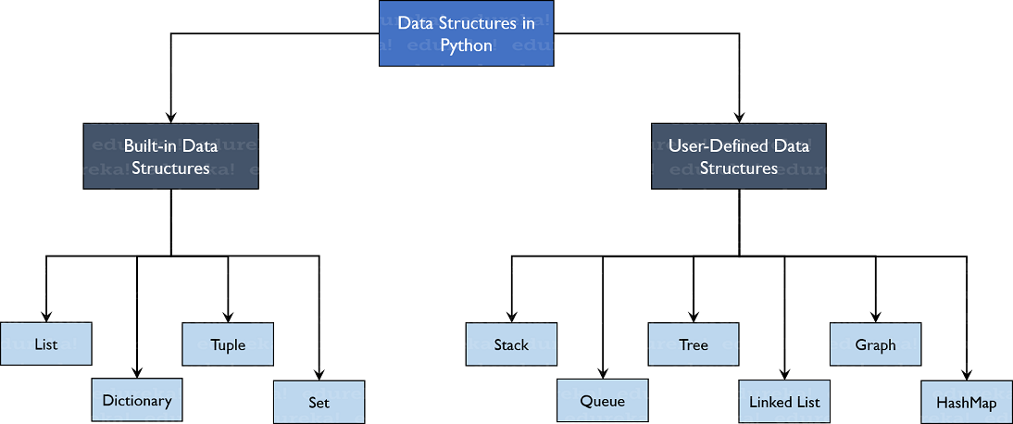
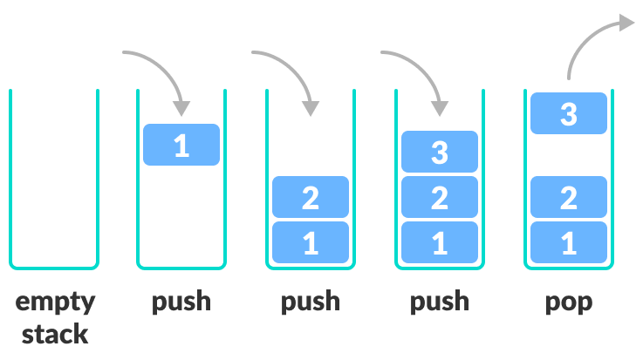
-> Data structure in python
...........................................................................................................................................................................................
Python Stack ->
A Stack is a data structure that follows the LIFO(Last In First Out) principle
push - It adds an element to the top of the stack.
pop - It removes an element from the top of the stack.
x = [1, 2, 3]
x.append(4) # append=push operation
x.append(5)
print(x)
print(x.pop())
print(x)
print(x.pop())
print(x)

Slide 19
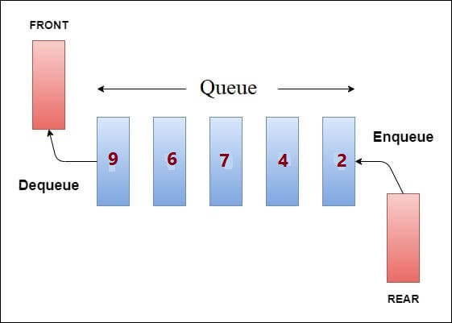
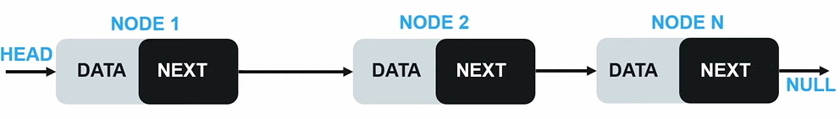
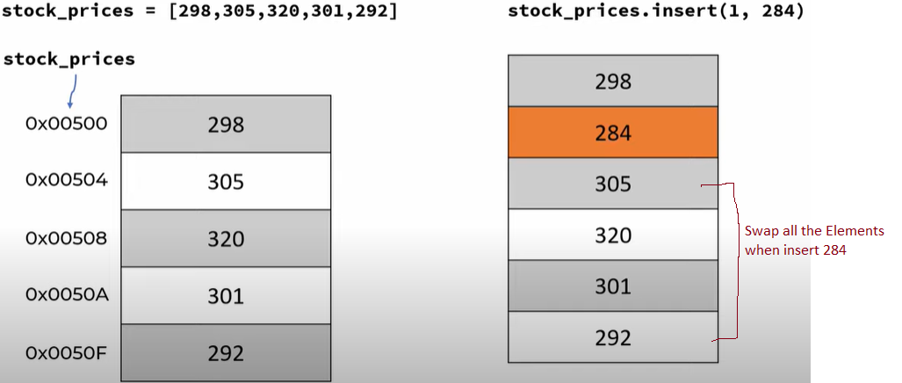
Python Queue:->
A Queue follows the First-in-First-Out (FIFO) principle
enqueue - It adds an element to the end of the queue.
dequeue - It removes the element from the beginning of the queue.
..........................................................................................................................................................................................................................................
->Linked List
import queue
# Queue is created as an object 'L'
L = queue.Queue(maxsize=10)
# Data is inserted in 'L' at the end using put()
L.put(9)
L.put(6)
L.put(7)
L.put(4)
# get() takes data from
# from the head
# of the Queue
print(L.get())
print(L.get())
print(L.get())
print(L.get())
Normal List
my_lst=list(range(0 ,10))
print(my_lst)
my_lst.insert(2,50);
print(my_lst)
my_lst.remove(50);

Slide 20
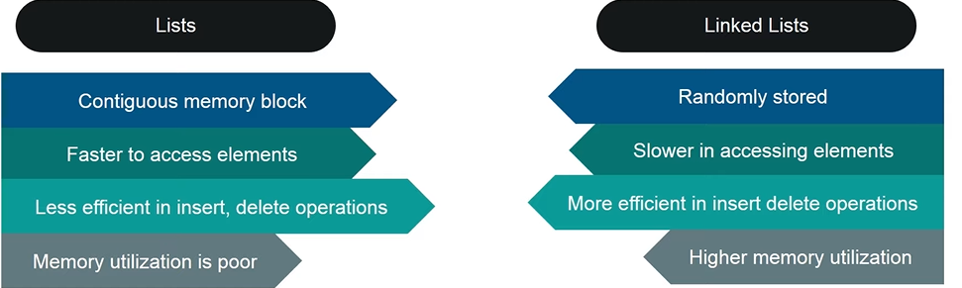
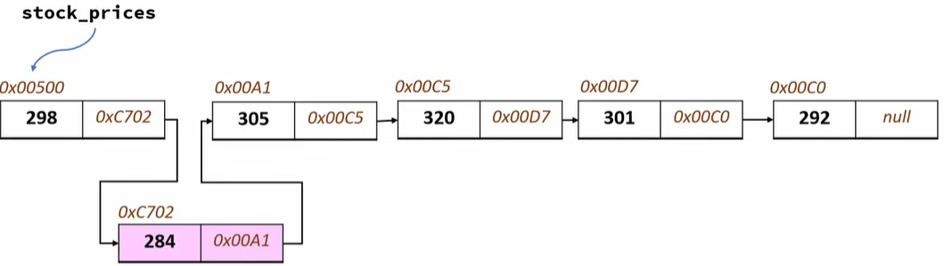
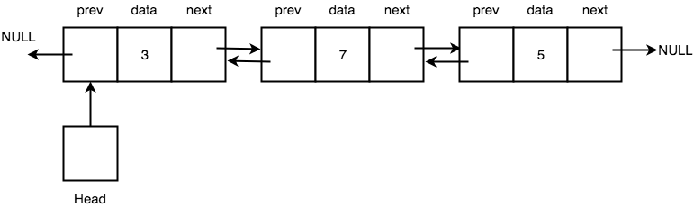
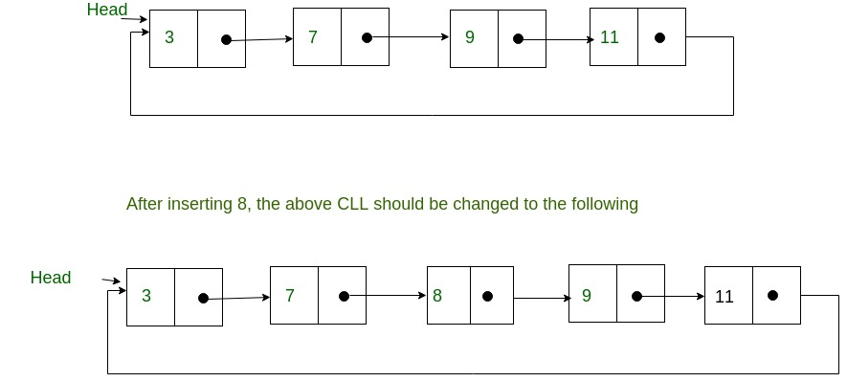
-> Single Linked List
->Doubly Linked List
-> Circular Linked List

Slide 21

Non-Linear Data structure
Tree->Trees are hierarchical structures having a single root node.
class A:
def __init__(self, data):
self.data = data
self.children = []
self.parent = None
def add_child(self, child):
child.parent = self
self.children.append(child)
def print_tree(self):
print(self.data)
if self.children:
for child in self.children:
child.print_tree()
def run():
root = A("A")
B = A("B")
B.add_child(A("C"))
B.add_child(A("D"))
root.add_child(B)
M = A("M")
M.add_child(A("N"))
M.add_child(A("P"))
root.add_child(M)
root.print_tree()
if __name__ == '__main__':
run()
class A:
def __init__(self, data):
self.data = data
self.children = []
self.parent = None
def add_child(self, child):
child.parent = self
self.children.append(child)
def get_level(self):
level = 0
p = self.parent
while p:
level += 1
p = p.parent
return level
def print_tree(self):
spaces = ' ' * self.get_level() * 3
prefix = spaces + "|__" if self.parent else ""
print(prefix + self.data)
if self.children:
for child in self.children:
child.print_tree()
def run():
root = A("A")
B = A("B")
B.add_child(A("C"))
B.add_child(A("D"))
root.add_child(B)
M = A("M")
M.add_child(A("N"))
M.add_child(A("P"))
root.add_child(M)
root.print_tree()
if __name__ == '__main__':
run()
Root Node
A
Node
B
M
C
D
N
P
Leaf Node
Example ...

Slide 22
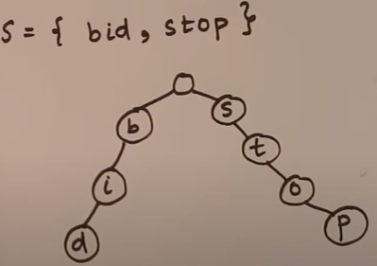
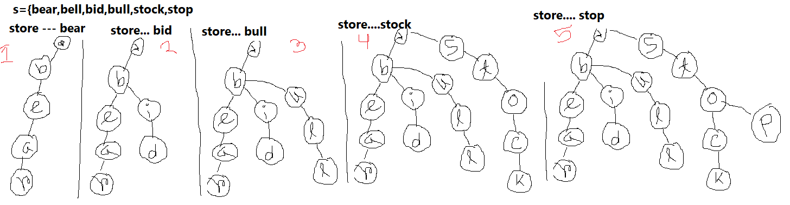
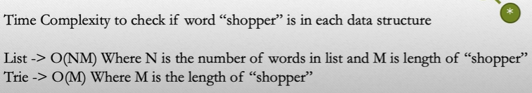
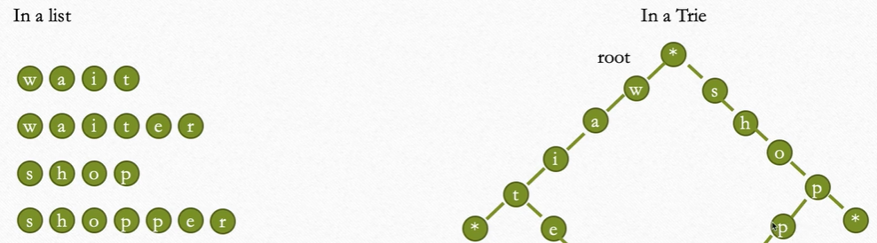
Tries
i) Data store as a tree
ii) stores a set of string
iii) every node(except root) will store a Latter in the alphabet
........................................................................................................................................................................................................
Difference between List and Tries .....?

Slide 23
class Trie(object):
def __init__(self):
self.child = {}
def insert(self, word):
current = self.child
for l in word:
if l not in current:
current[l] = {}
current = current[l]
current['#']=1
def search(self, word):
current = self.child
for l in word:
if l not in current:
return False
current = current[l]
return '#' in current
def startsWith(self, prefix):
current = self.child
for l in prefix:
if l not in current:
return False
current = current[l]
return True
ob1 = Trie()
ob1.insert("bear")
ob1.insert("bell")
ob1.insert("bid")
ob1.insert("bull")
ob1.insert("stock")
ob1.insert("stop")
print(ob1.search("apple"))
print(ob1.startsWith("app"))
print(ob1.search("bear"))
print(ob1.startsWith("bes"))
Trie Example ...

Slide 24
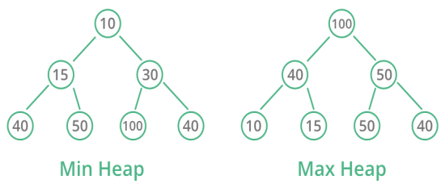
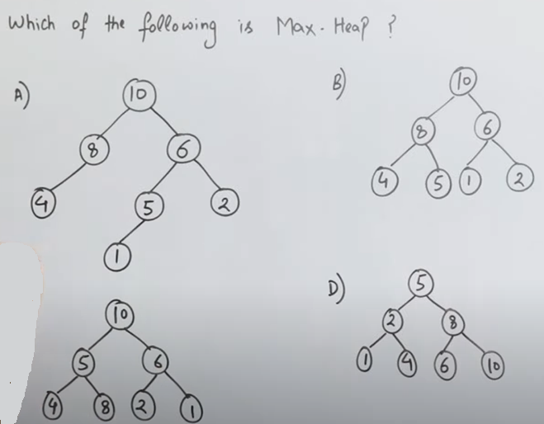
Heap
A Heap is a special Tree-based data structure in which the tree is a complete binary tree(must be every node have two children) or almost complete binary tree. Generally, Heaps can be of two types:
Max-Heap: In a Max-Heap the key present at the root node must be greatest among the keys present at all of it’s children.
The same property must be recursively true for all sub-trees in that Binary Tree.
Min-Heap: In a Min-Heap the key present at the root node must be minimum among the keys present at all of it’s children.
The same property must be recursively true for all sub-trees in that Binary Tree.
Note-> By default Min Heap is implemented by this class. But we multiply each value by -1 so that we can use it as MaxHeap.
#Minheap (using Library function)
from heapq import heapify, heappush, heappop
# Creating empty heap
heap = []
heapify(heap)
# Adding items to the heap using heappush function
heappush(heap, 10)
heappush(heap, 5)
heappush(heap, 20)
heappush(heap, 400)
heappush(heap,2)
# printing the value of minimum element
print("Head value of heap : "+str(heap[0]))
# printing the elements of the heap
print("The heap elements : ")
for i in heap:
print(i, end = ' ')
print("\n")
element = heappop(heap)
# printing the elements of the heap
print("The heap elements : ")
for i in heap:
print(i, end = ' ')
#maxheap (using Library function)
from heapq import heapify, heappush, heappop
# Creating empty heap
heap = []
heapify(heap)
# Adding items to the heap using heappush function
heappush(heap,-1 * 10)
heappush(heap,-1 * 5)
heappush(heap,-1 * 20)
heappush(heap, -1 * 400)
heappush(heap,-1 * 2)
# printing the value of minimum element
print("Head value of heap : "+str(-1 * heap[0]))
# printing the elements of the heap
print("The heap elements : ")
for i in heap:
print(-1 * i, end = ' ')
print("\n")
element = heappop(heap)
# printing the elements of the heap
print("The heap elements : ")
for i in heap:
print(-1 * i, end = ' ')

Slide 25
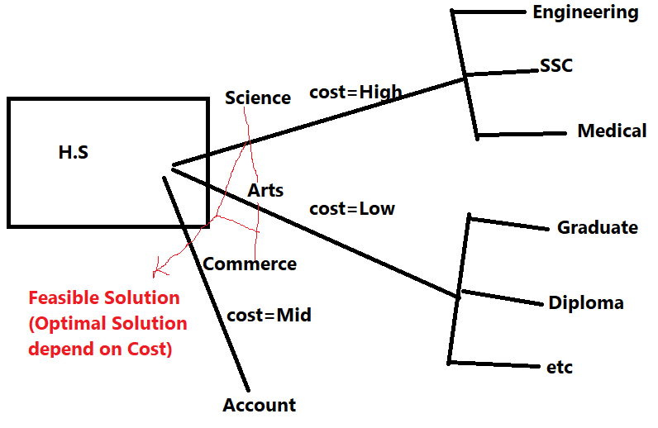
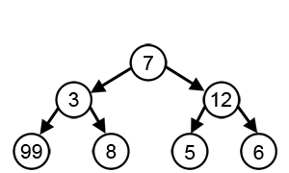
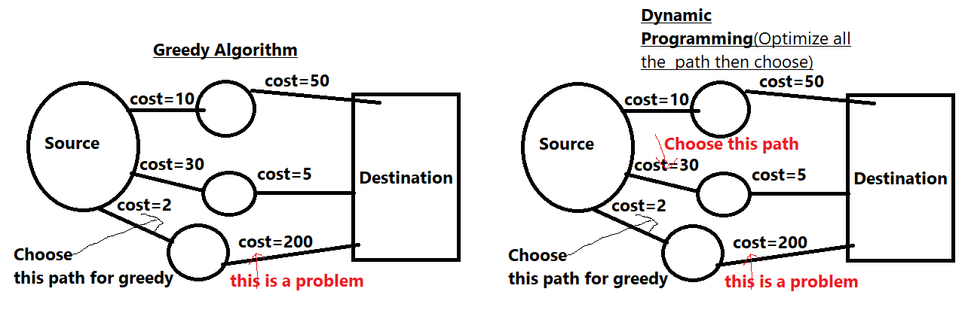
Greedy
Greedy algorithms (Solve Optimization Problem(May or May not be true) ) aim to make the optimal choice at that given moment. Each step it chooses the optimal choice, without knowing the future. It attempts to find the globally optimal way to solve the entire problem using this method.
Dynamic Programming (Solve Optimization Problem(always
provide optimal answer) ->it divide the problem into series of
overlapping sub problems .
Difference Divide & concur and Dynamic Programming ->
Divide & concur do not repeated the sub-problems but Dynamic
Programming Repeat the Sub-problems .
Greedy approach. Here is a list of few of them −
1.Travelling Salesman Problem
2.Prim's Minimal Spanning Tree Algorithm
3.Kruskal's Minimal Spanning Tree Algorithm
4.Dijkstra's Minimal Spanning Tree Algorithm
5.Graph - Map Coloring
6.Graph - Vertex Cover
7.Knapsack Problem
8.Job Scheduling Problem
Dynamic Programming is mainly an optimization over plain recursion. Wherever we see a recursive solution that has repeated calls for same inputs, we can optimize it using Dynamic Programming. The idea is to simply store the results of sub problems, so that we do not have to re-compute them when needed later.
Example -> Factorial programme using Recursion

Slide 26
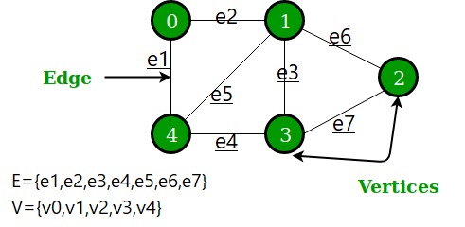
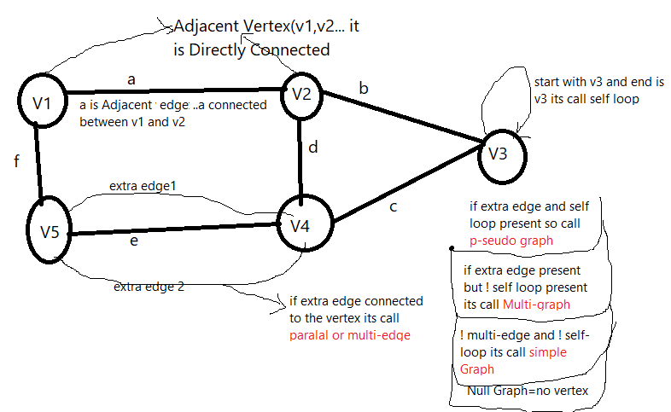
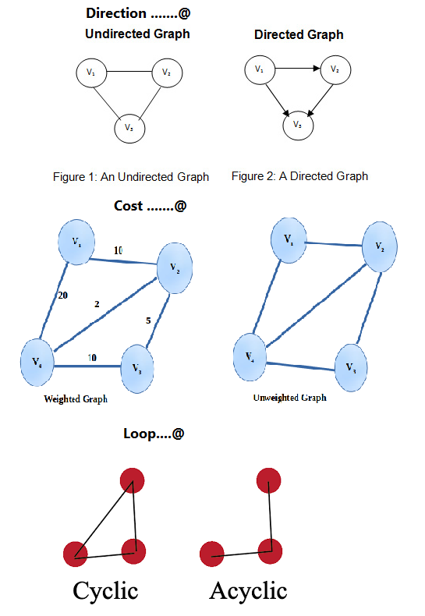
Graph
1.Graph is a non-linear data-structure
2.Graph collection of vertex(V) and edge(E)
Note->
V=Order of Graph
E=Size of Graph
-> Every tree is a Graph But Graph is not a tree

Slide 27
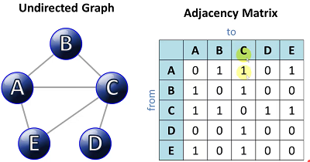
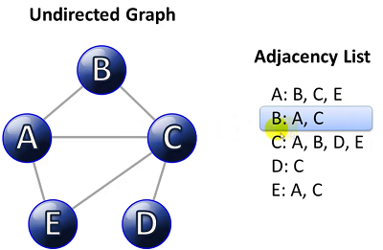
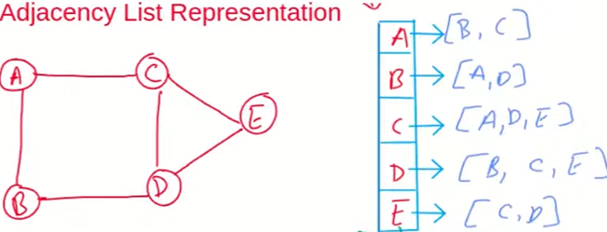
Graph Represent
there are two ways to represent on the python graph .................................
Adjancy List
Adjancy Matrix
.......................................................................................................................................................................................................................
Adjancy List
Simple Program Adjancy List...
all_edges=[("A","B"),("A","C"),("B","D"),("C","D"),("C","E"),("D","E")]
class Graph:
# Initialize the matrix
def __init__(self, Nodes):
self.nodes = Nodes;
self.adj_list={}
for node in self.nodes:
self.adj_list[node]=[]
# Add edges
def add_edge(self, u, v):
self.adj_list[u].append(v)
self.adj_list[v].append(u)
# Print the matrix
def print_adj_list(self):
for node in self.nodes:
print(node,"->",self.adj_list[node])
nodes=["A","B","C","D","E"]
graph=Graph(nodes)
#main vertex print
graph.print_adj_list()
for u,v in all_edges:
graph.add_edge(u,v)
graph.print_adj_list()
adj_list={
"A":["B","C"],
"B":["A","D"],
"C":["A","D","E"],
"D":["B","C","E"],
"E":["C","D"]
}
print(adj_list["A"])

Slide 28
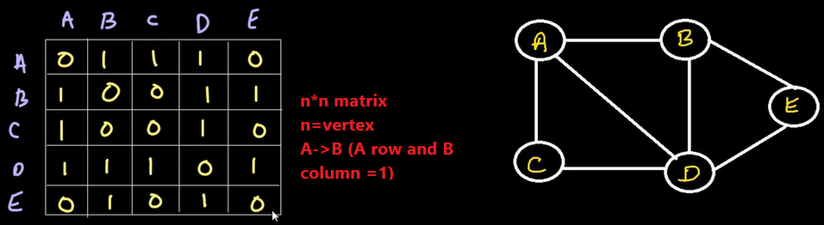
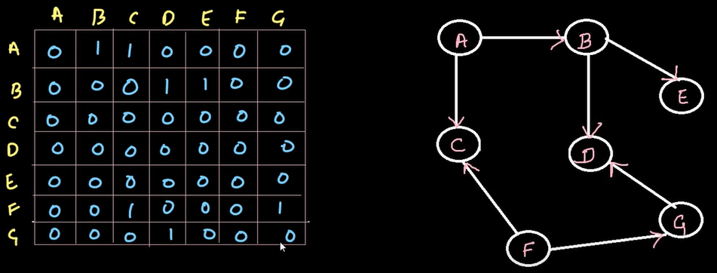
2.Adjancy Matrix(Graph) ..
Simple Code....
# Print the matrix
def print_matrix(self):
for row in self.adjMatrix:
print("\n")
for val in row:
print(val,end=""),
print
g = Graph(5)
#(row=0(A),coulm (A=0,B=1,C=2,D=3,E=4))
g.add_edge(0, 1)
g.add_edge(0, 2)
g.add_edge(0, 3)
#(row=1(B),coulm (A=0,B=1,C=2,D=3,E=4))
g.add_edge(1, 0)
g.add_edge(1, 3)
g.add_edge(1, 4)
#(row=2(C),coulm (A=0,B=1,C=2,D=3,E=4))
g.add_edge(2, 0)
g.add_edge(2, 3)
#(row=3(D),coulm (A=0,B=1,C=2,D=3,E=4))
g.add_edge(3, 0)
g.add_edge(3, 1)
g.add_edge(3, 2)
g.add_edge(3, 4)
#(row=4(E),coulm (A=0,B=1,C=2,D=3,E=4))
g.add_edge(4, 1)
g.add_edge(4, 3)
g.print_matrix()
class Graph(object):
# Initialize the matrix
def __init__(self, size):
self.size = size # create size global variable
self.adjMatrix = [] # List
for i in range(size): #fill list with 0
self.adjMatrix.append([0 for i in range(size)])
# Add edges
def add_edge(self, v1, v2):
if v1 == v2:
print("Same vertex %d and %d" % (v1, v2))
self.adjMatrix[v1][v2] = 1
self.adjMatrix[v2][v1] = 1
# Remove edges
def remove_edge(self, v1, v2):
if self.adjMatrix[v1][v2] == 0:
print("No edge between %d and %d" % (v1, v2))
return
self.adjMatrix[v1][v2] = 0 # A connect to B
self.adjMatrix[v2][v1] = 0 # B connect to A
adj_list={
"A":[0,1,1,1],
"B":[1,0,1,1],
"C":[1,1,0,1],
"D":[1,1,1,0]
}
#print(adj_list["A"])
for m in adj_list:
print(adj_list[m])

Slide 29
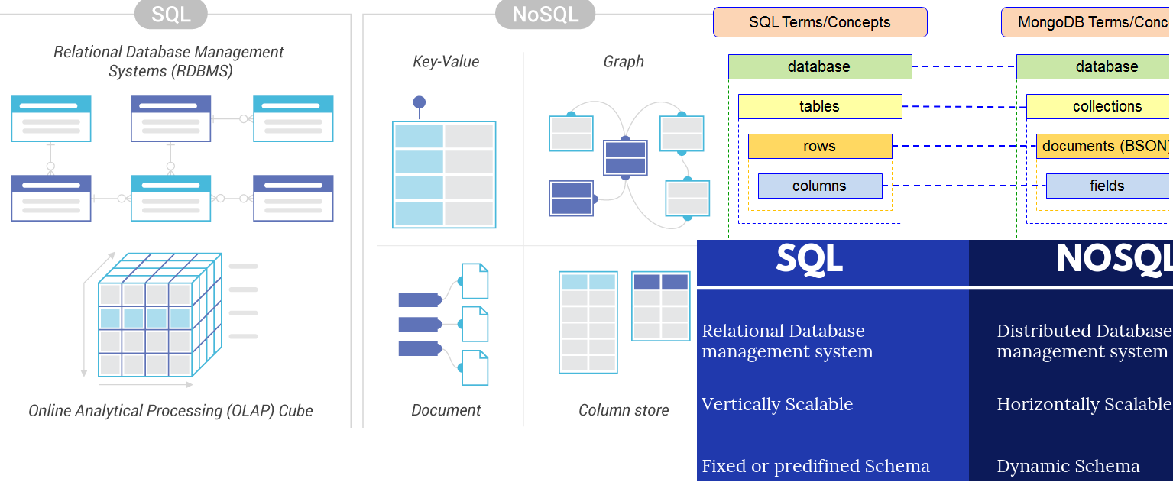
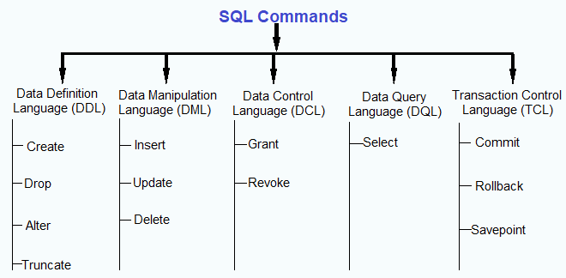
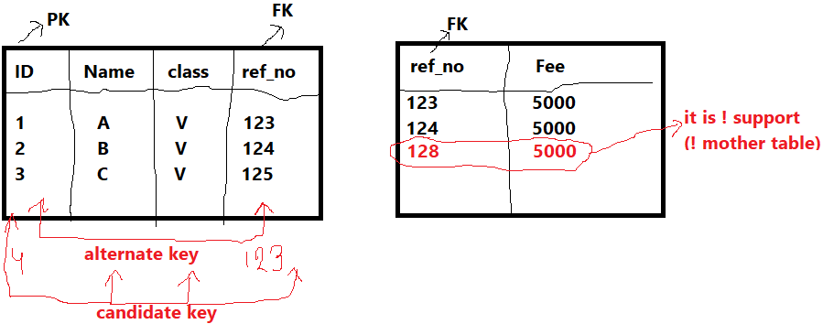
-> Difference Between SQL and NO-SQL

Slide 30
SQL command Example →
DDL(Data Defination Language)
1.create..
create database database_name;
create table table_name(id int,name char(20))
2.drop ..(delete table)
drop table table_name
3.truncate(clear all data )
truncate table table_name
4.alter ( table structure change)
alter table table_name add column column_name data type
DML(Data Manipulation Language)
1. insert
insert into table_name(id,name) values(1,'aa')
2.update
update table_name set id=25 where name='aa';
3.delete
delete from table_name where id=25;
TCL(Transaction Control Language)
1. savepoint(undo position)
START TRANSACTION;
savepoint savepoint_name ;
insert into table_name(id,name) values(1,'aa');
2.rollback (undo)
rollback to savepoint savepoint_name;
1.commit(Fixed= !undo)
commit;
DCL(Data Control Language)
1. Grant ( Access Authorization )
grant <previlege list> on table_name to user
exam--grant all on ab to abc;
2.Revoke(Access Denied)
revoke all on ab from abc;

Slide 31
-> Database Connection[pip install mysql-connector]

Slide 32
6.4 Python os module:->
The os module provides us the functions that are involved in file processing operations like renaming, deleting, etc.

Slide 33
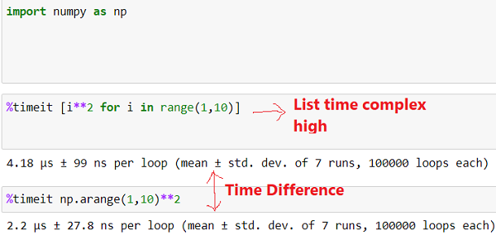



NumPy:->Numpy stands for Numeric Python ,it use for numeric and scientific computing also use multidimensional Array.
It also has functions for working in domain
of linear algebra, and matrices.
Difference between List and Numpy Library ->
# List 2d array
pl=[[1,2,3],[5,8,9]]
pl[1][0]
Why is NumPy Faster Than Lists?
NumPy arrays are stored at one continuous
place in memory unlike lists,
so processes can access and manipulate them
very efficiently.

Slide 34


-> Why Numpy
-> Data convert into Numpy array for ML model Train
-> How to use Numpy Array
i) install Numpy (pip install numpy )
ii) Import numpy as np

Slide 35




Linear Equation Solve by numpy ➔
Inverse Matrix ...>
Eigen Value & eigen Vector find
a=np.array([[3,1],[1,2]])
b=np.array([9,8])
np.linalg.solve(a,b)
Fst row, x=3 ,y=1
2nd row, x=1 ,y=2
Constant value = 9,8
a=np.array([[1,2,-2],[-1,3,0],[0,-2,1]])
np.linalg.inv(a)
a=np.array([[2,5],[1,3]])
np.linalg.inv(a)
#Eigen value & Eigen vector
a=np.array([[1,2,-2],[-1,3,0],[0,-2,1]])
eigen_value,eigen_vector=np.linalg.eig(a)
print("eigen value",eigen_value)
print("eigen vector",eigen_vector)

Slide 36



Pandas->Pip install pandas
Its use for data manipulation and data analysis, its contain single (Series object)and multidimensional(DataFrame).
reading and writing different formats : .csv,.tsv,.txt etc
Data structure for data manipulation
Difference between Numpy and Pandas:->
All, elements in NumPy arrays are accessed by their integer position, starting with zero for the first element. A pandas Series Object is more flexible as you can use define your own labeled index to index and access elements of an array.
Numpy array is used for the implementation of pandas data object.
->Pandas DataStructure
Why Pandas ....Data Preprocessing
Series.....1d
DataFrame .2d

Slide 37

Pandas Library Work.......
DataFrame Create Through Pandas
import pandas as pd
#one dimensional array =Series object
s=pd.Series([15,8,9,48])
print(s)
print(s[2]) # you have used list all the property
#index value change
s=pd.Series([15,8,9,48],index=['a','b','c','d'])
print(s)
#dictionary through pandas
s=pd.Series({'k1':15,'k2':8,'k3':9,'k4':48})
print(s)
# dictionary through pandas and key value change
s=pd.Series({'k1':15,'k2':8,'k3':9,'k4':48},index=['k3','k2','k1','k5'])
print(s)
# sum of Series
s=pd.Series([15,8,9,48])
s1=pd.Series([2,4,6,8])
print(s+2) # add,subtruct,multiple ,division operation use
s3=s+s1
print(s3)
s=pd.DataFrame({"name":['som','som2','som3','som4','som5','som6','som7'],"mks":[12,16,15,85,89,55,57]})
print(s)
print(s.head()) # fst 5 data show
print(s.tail()) # lst 5 data show
print(s.shape) # Row and column show
print(s.describe()) # Describe DataFrame
Pandas Describe Function Use
STD

Slide 38


---→ Exploratory Data Analysis(EDA)
Exploratory Data Analysis refers to the critical process of performing
initial investigations on data so as to discover patterns,to spot anomalies,
to test hypothesis and to check assumptions with the help of summary
statistics and graphical representations.
EDA use Practically ----
Library use→ Pandas ,MatplotLib,Seaborn
Average Salary Find (Data Science)
But 80000 is wrong data for our
Prediction so delete this data and Prediction .

Slide 39


Read CSV File
……………………………………………………………………………………………………………………………………………………………………
MatplotLib:-> :> Its help to draw Data visualization.
Why Data Visualization :->Human brain can process
information easily when it is in graphical from .
Installl → pip install matplotlib
Import → import matplotlib as plt
from matplotlib import pyplot as plt
------ pyplot is a module of matplotlib
s3=pd.read_csv("D:\data.csv")
print(s3)
print(s3.iloc[0:2,0:2]) # 2 row and 2 column(index wise) read
#s3.drop(0) # delete row
#s3.drop('Year',axis=1) #delete column
#s3.drop([1,2,3],axis=0) # perticular row del
# Function through interest calculation
def interest(s):
return s+((s *3)/100)
s3['Balnc'].apply(interest)
#Repeat value count
s3['Monthly_Credit'].value_counts()
Types of Plot

Slide 40


MatplotLib
Scatter Plot Create
-> Pie Plot Create
import matplotlib.pyplot as plt
import pandas as pd
#Read CSV File
data=pd.read_csv("bank_loan.csv")
data
#scatter Plot Create( Matplotlib)
data.plot(kind='scatter',x='Balnc',y='Loan_Eli')
plt.title("my fst plot")
plt.ylabel("y-axis")
plt.xlabel("x-axis")
plt.show()
import matplotlib.pyplot as plt
import pandas as pd
#Read CSV File
data=pd.read_csv("bank_loan.csv")
# Creating dataset
balnc = list(data['Balnc'])
data1 = data['Loan_Eli']
# Creating plot
fig = plt.figure(figsize =(10, 7))
plt.pie(balnc, labels = data1,autopct='%.0f%%',shadow = True)
# show plot
plt.show()
Practice Example File

Slide 41


Seaborn→
-> Graph Create (using Seaborn )
-> Pair Plot
# Graph Create (using Seaborn )
import matplotlib.pyplot as plt
import pandas as pd
Import seaborn as sns
sns.set_style("whitegrid")
g=sns.FacetGrid(data,hue='Balnc',height=4)
g.map(plt.scatter,x='Balnc',y='Loan_Eli')
g.add_legend();
plt.show()
#we can see only 2d or 3d data , upper version use pair plot
# Many types of Graph you can sea with Line( 3 Dimension < )
sns.set_style("whitegrid")
sns.pairplot(data,hue='Balnc',height=4)
plt.show()

Slide 42



Data PreProcessing

Slide 43



-> What is Data Cleaning ?(Data Cleansing )
-> Data Integration

Slide 44


->Data Reduction
-> Data Transformation

Slide 45


-> Data Discretization
→ Prerequisites for Data Preprocessing

Slide 46


-> what is Feature Engineering
-> why is feature Engineering Important?
->

Slide 47

-> Example of Feature Engineering
-> What is Vriable of Feature Enginerring
Column value = Variable like ---- id ={1,2,3,4} .... 1 ,2 3 all are integer type variable
Types of Variable ...
A) Numerical(2 types...>1) Discrete = int value , ii) Continuous= float value)
B) Categorical = group type variable
( 2 types... 1)Ordinal= Mathematically order like A,B,C , D etc or * , **,***,**** etc
2) Nominal=No Mathematically order all variable priority are same like – programming Language ,,C,C++,Java etc )
c) Date & Time ( Date only or Time only or Date & time )
Ex-- Search on Flipcart product then flipcart store Date and Time & product then suggest on your face book page or any other platform
d) Mixed (Label Data like string type data like contain date & time or numeric or Categorical data )

Slide 48


-> Kaggle Datasets
This is a website .......> https://www.kaggle.com/ then go to register section & register yourself
And download your best Dataset .

Slide 49

-> Handle Missing Values
How many ways to fill our Missing values ?

Slide 50


->Practically Understand AI,ML,DL
-> Machine Learning
Example .....
Google recommendation
Amazon or Flipcart product suggest

Slide 51

->Deep Learning

Slide 52









What is Machine Learning ?
Machine learning is the study of computer algorithms that improve automatically
through experience. It is seen as a subset of artificial intelligence.
Why ->Simply put, machine learning allows the user to feed
a computer algorithm an immense amount of data and have
the computer analyze and make data-driven recommendations
and decisions based on only the input data.
History of Machine Learning ->?
Test
Game Create
Now

Slide 53


-> How does Machine Learning Work ?
-> What is Data Mining
-> What is Predictive Modelling

Slide 54





Types of Machine Learning
Supervised Learning ->
Supervised Learning is when the model is getting trained on a labelled dataset .
Labelled DataSet .... Input (2 ,2) , output (4) both include .
Why/ where use Supervised Learning

Slide 55




Unsupervised Learning ->?
Unlabelled data (output not include)
It is use for Recommendation System
(Like.. Amazon, Flipcart etc )
Unsupervised Algorithm ......
Reinforcement Learning ->?
Reinforcement Learning is a type of Machine Learning where an agent learns to behave in a environment by performing actions and seeing the result .
Note->Robot based Learning Real Life Example

Slide 56


Life cycle of Machine Learning ?
Define Project Objectives
Specify Business Problem
Requirements
2. Data Collection
Primary data- collected by researcher
from first-hand source
Secondary Data-Collected by someone
Else and already been passed through the statistical process.
3. Data PreProcessing
Data cleaning
Data Transformation
Dimentionality Reduction ......... X & Y Relationship (x(blnc,monthly_income,act_type) independed and y(loan_elg) depended)
4. Data Visulation
Graphical represent of Data(X and Y relationship )
5.Model Selection
(Linear Regression, Logistic Regression, Random Forest,k-Means Clustering)
6.Model Building

Slide 57


Supervised Learning
-> What is Train Test Split Data
->Regression

Slide 58

-> Simple Linear Regression Math Concept

Slide 59



-> Simple Linear Regression ML Concept
Formula ......@
y=mx+b
m= coeffient , x=our independent value , b= intercept

Slide 60



-> Linear Regression Multiple Variable
More than one field(features)
When Our ML model ! Predict the accurate value so use , Features scaling .
-> What is an Error (cost Function)

Slide 61

->Features scaling

Slide 62


-> Why Features Scaling ?
-> Which Algorithm is very important for Features scaling

Slide 63



->Types Of Features Scaling
-> what is Standardization
Gaussian distribution

Slide 64



-> What is Normalization
-> Difference between Standardization & Normalization

Slide 65

->Gaussian distribution

Slide 66

-> Polynomial Linear Regression

Slide 67

-> Support Vector Regression -- Support vector regression finds a linear function representing the data within a margin of error.

Slide 68


-> Decision Tree Concept of ML

Slide 69


->Ensemble Technique

Slide 70


-> Calculation(Decision Tree Regression)
-> Random Forest Concept(Ensemble Technique use ( Decision Tree Algorithm ).

Slide 71


-> Random Forest Regression

Slide 72

->Logistic Regression(Classification)

Slide 73



-> K Nearest Neighbor Classification
-> Behind Math
If k is 5 so 5 nearest distance Find majority is output But try to K value always odd

Slide 74

-> KNN Math Calculation

Slide 75

-> Support Vector Machine – classify all the things

Slide 76

-> property

Slide 77

->Naive Bayes

Slide 78

->unrevised Learning
---->k means clustering
Real Life use --- grouping data

Slide 79


-> Reinforcement Learning = Self Learning
-> Reinforcement Learning Process

Slide 80

-> RL learning Process

Slide 81

->Recommendation System

Slide 82


->Deep Learning

Slide 83

-> Deep Learing Framework
--→ Keras and tensorflow and pytorch
Difference Between Keras and tensorflow and pytorch

Slide 84

-> NLP (Natural Language Processing )
human and machine communicate directly
Exampl- > speech regonition ,google translation
What is the technique of NLP

